Slide 1
LINe: Out of Distribution Detection by Leveraging Important Neurons.

Slide 2
Out-of-Distribution (OOD) Detection
Goal
Identify the input is In-Distribution(ID) or Out-of-Distribution
Post-hoc Method
No need of retraining process
Model logits or layer activations – used for prediction and calculating OOD scores
Improve post-hoc performance
Enhancing the overall OOD score distribution difference between ID and OOD data.
Minimize the effect of noisy model outputs.
Current Issue in OOD detection Methods
Reducing the Noisy Outputs – Recent studies (ReAct, DICE) found that reduce the impact of noisy signals enhance the OOD detection performance.

Slide 3
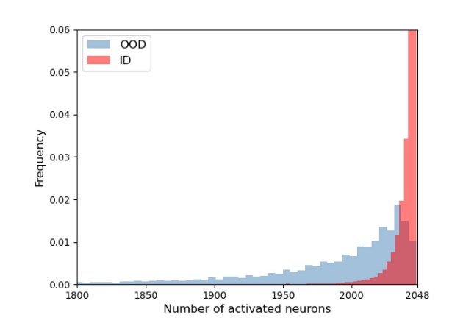
Activated Neurons
Neuron Concept Association
Neurons are trained to detect disentangled high level features in the deep
layers of CNNs.
Number of neurons representing high level features is in most significant
amount in the penultimate layer.
There fore penultimate layer is used to predict the input image’s class.
Disparity in associated high level features in neurons results in a difference in penultimate layer activation between ID and OOD samples.
There fore number of activated essential neurons is a useful indicator for distinguishing ID and OOD samples.
Majority of neurons are activated when models encounter ID samples.

Slide 4
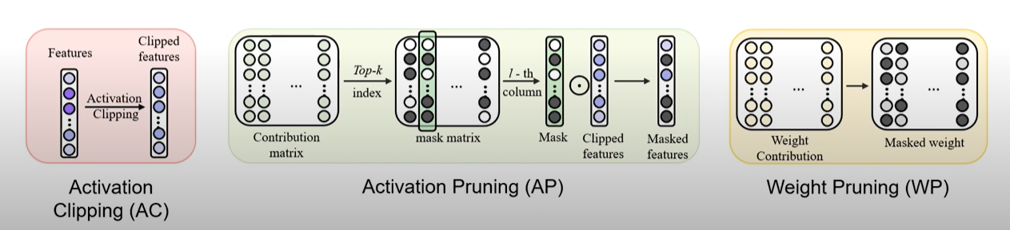
Two aspects considered in LINe:
Reducing noisy signal from less important neurons.
Considering the number of activated high-level features.
LINe uses two techniques:
Shapley value based pruning
Reduce the effect of noisy outputs
Activation Clipping
Fixes all values above a certain threshold into a same value.

Slide 5
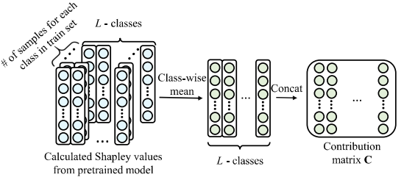
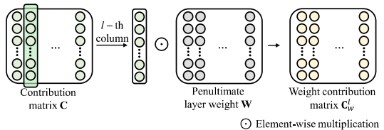
Method
Activation Clipping
Applied to the feature vector in the penultimate layer.
Limits the magnitude of the activation for each neurons activated above a certain threshold.
Increases the OOD score difference between ID and OOD samples.
Shapley-based Pruning - Selectively uses the subset of important neurons activations and weights.
Activation Pruning
Selectively uses the subset of important neuron activation.
Reduces the impact of noisy activation.
Weight Pruning
Selectively uses the subset of important penultimate layer weights.
Reduces the impact of noisy signal due to overparameterized model.
Determines the neurons representing important high level features for each class.

Slide 6
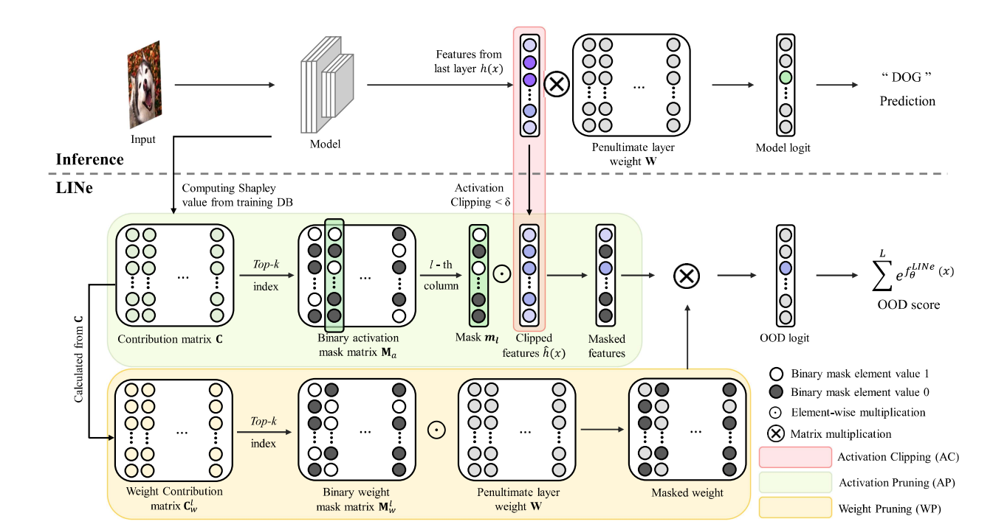
Overall procedure of LINe for calculating OOD scores.

